Slide 1

Tomorning
Group 4
Ximin Zhang
Florence Huang
Shayne He

Slide 2

Introduction
Sleeping Concept
Deep Stage
Light Stage

Slide 3
What does our App do?
Alarm ( Version 1 )
Assessment Report ( Version 2)
-- Nice Graph of Sleeping Status
-- Sleeping Summary
-- Sharing Options
Calendar & Weather ( Version 3)
-- Weather Condition Display
-- Event Item Add and Delete
-- Import System Calendar
-- Switch to Calendar after Alarm Triggered
Settings ( Version 3)
-- More Themes & Music & Languages provided
-- System backup alarm option
-- About Us

Slide 4
What does our App Can’t do
Improve Sleep
Medical Use
Internet Needed
DIY Photo

Slide 5
Current Version (1)
Alarm, not with Healthkit
Whole project Structure
Background image
Beautiful Rotating Clock
Setting Buttons
Healthkit Enable needed

Slide 6
Testing
Unit test
IOS Simulator
User Acceptance Test

Slide 7

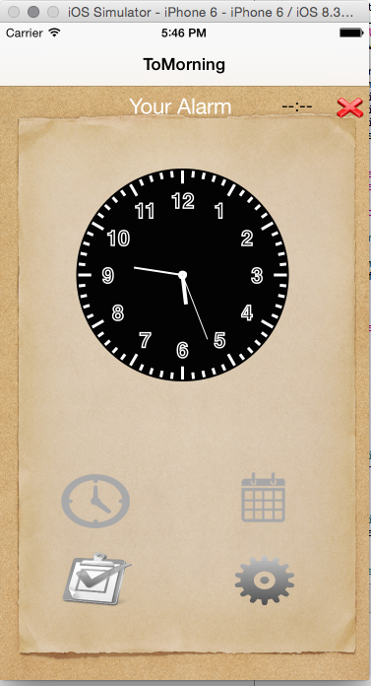
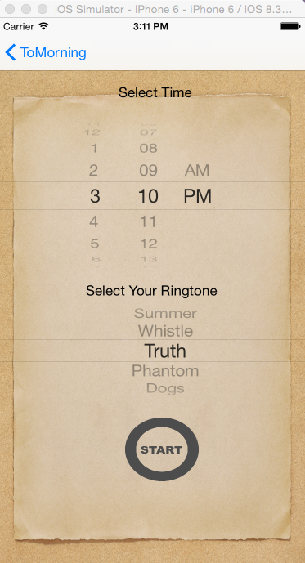
Set Alarm: Time and Music

Slide 8
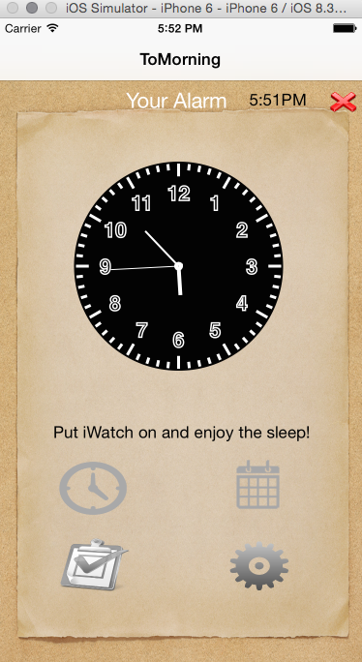
Cancel Alarm & Reset

Slide 9
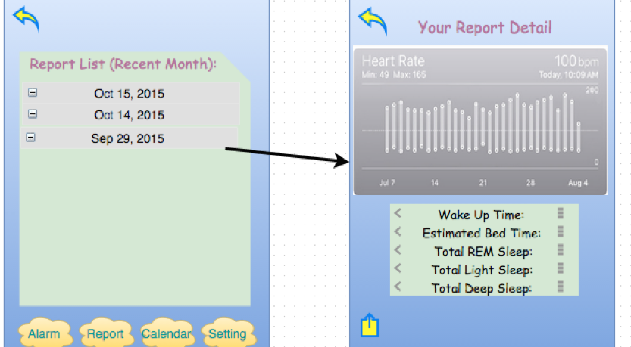
Sleeping Assessment Report
Coming soon

Slide 10
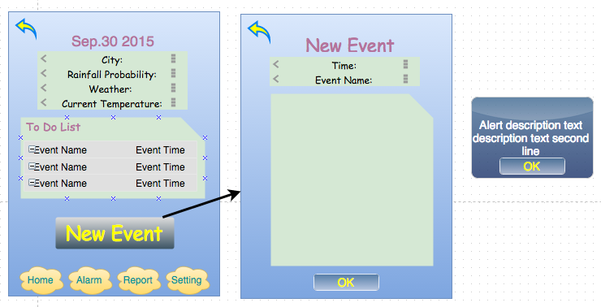
Calendar & Weather
Coming soon

Slide 11
Demonstration
https://youtu.be/-MOwN28-gO4
Enjoy Watching

Slide 12
Thank you!
QUESTION?

